Slide 1
FLIGHT PRICE PREDICTION
By-
Ganesh kumbhar

Slide 2
INTRODUCTION
• Business Problem Framing
Anyone who has booked a flight ticket knows how unexpectedly the prices vary. The cheapest available ticket on a given flight gets more and less expensive over time. This usually happens as an attempt to maximize revenue based on - 1. Time of purchase patterns (making sure last-minute purchases are expensive) 2. Keeping the flight as full as they want it (raising prices on a flight which is filling up in order to reduce sales and hold back inventory for those expensive last-minute expensive purchases)
• Conceptual Background of the Domain Problem
Airline companies use complex algorithms to calculate flight prices given various conditions present at that particular time. These methods take financial, marketing, and various social factors into account to predict flight prices. Nowadays, the number of people using flights has increased significantly. It is difficult for airlines to maintain prices since prices change dynamically due to different conditions. That’s why we will try to use machine learning to solve this problem. This can help airlines by predicting what prices they can maintain. It can also help customers to predict future flight prices and plan their journey accordingly

Slide 3
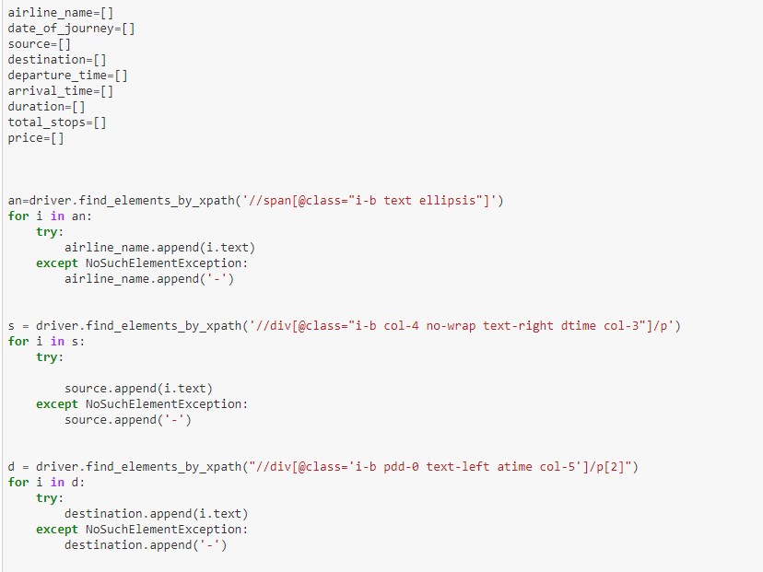
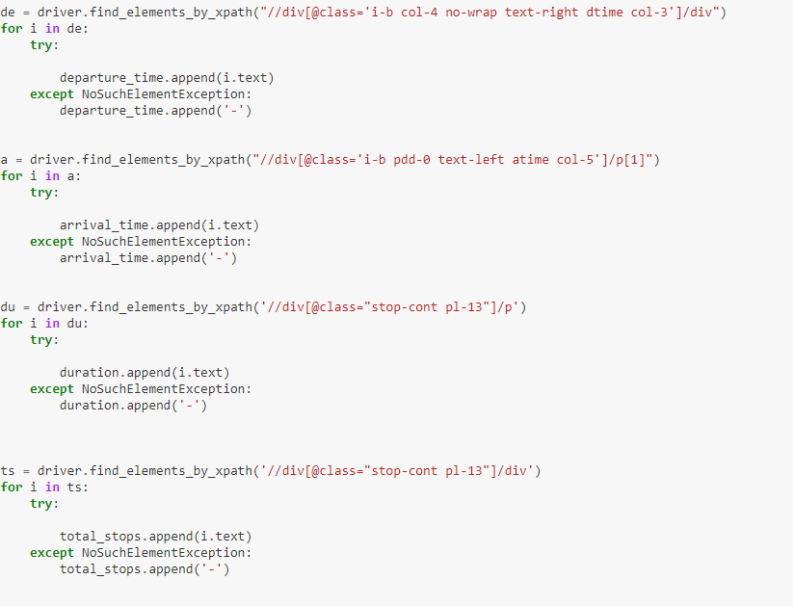
DATA COLLECTION USING WEB SCRAPING
I have used here selenium for web scraping

Slide 4
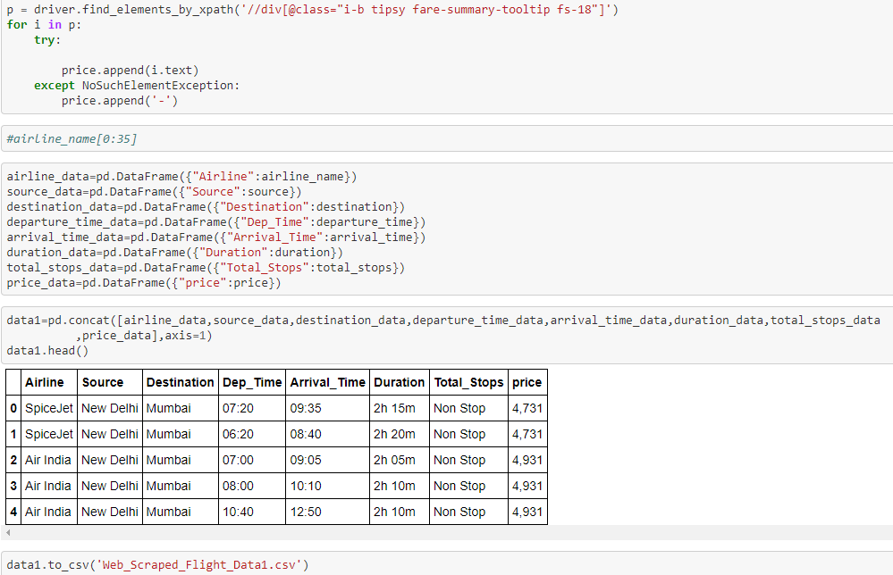
With the help of selenium I have scrapped 6730 rows of flight prices with 7 other features

Slide 5
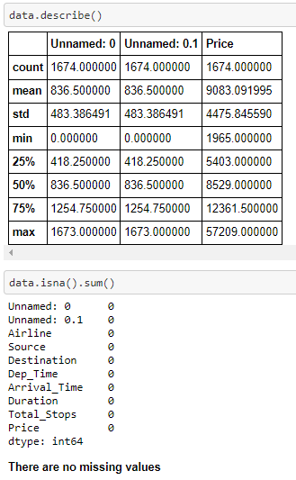
DATA LOADING AND PRE-PROCESSING
So here I have loaded my dataset with the help of pandas and I have used .describe() function that helps me to understand the spread of my data
And on the other hand we can see there Is no missing values in my data.
Airline | Source | Destination | Dep_Time | Arrival_Time | Duration | Total_Stops | price
0 | IndiGo\n6E-137/2046 | Jammu | Mumbai | 11:55 | 19:25 | 7h 30m | 2 Stop(s) | 7,365
1 | IndiGo\n6E-137/5041 | Jammu | Mumbai | 11:55 | 20:50 | 8h 55m | 2 Stop(s) | 7,365
2 | IndiGo\n6E-609/6722 | Jammu | Mumbai | 14:00 | 23:30 | 9h 30m | 2 Stop(s) | 7,365
3 | IndiGo\n6E-137/6722 | Jammu | Mumbai | 11:55 | 23:30 | 11h 35m | 2 Stop(s) | 7,365
4 | SpiceJet\nSG-160/945 | Jammu | Mumbai | 11:15 | 16:15 | 5h 00m | 1 Stop | 7,418
... | ... | ... | ... | ... | ... | ... | ... | ...
1095 | Vistara\nUK-998/747 | Pune | Kolkata | 16:55 | 08:35\n+ 1 day | 15h 40m | 1 Stop | 10,209
1096 | Vistara\nUK-998/705 | Pune | Kolkata | 16:55 | 09:35\n+ 1 day | 16h 40m | 1 Stop | 10,209
1097 | Vistara\nUK-998/737 | Pune | Kolkata | 16:55 | 18:05\n+ 1 day | 25h 10m | 1 Stop | 10,209
1098 | Vistara\nUK-998/707 | Pune | Kolkata | 16:55 | 19:35\n+ 1 day | 26h 40m | 1 Stop | 10,388
1099 | Air India\nAI-482/762 | Pune | Kolkata | 12:45 | 00:05\n+ 1 day | 11h 20m | 2 Stop(s) | 11,838
6730 rows × 8 columns

Slide 6

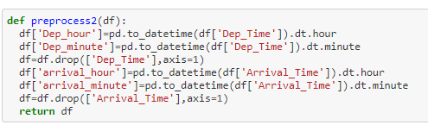
PRE-PROCESSING
Here in this pre-processing I am doing feature engineering using the present columns only and making my data more stable for the machine learning model and I am also dropping some columns that are not useful in my model so at the end I am getting a good clean data where I can do EDA on my data.

Slide 7
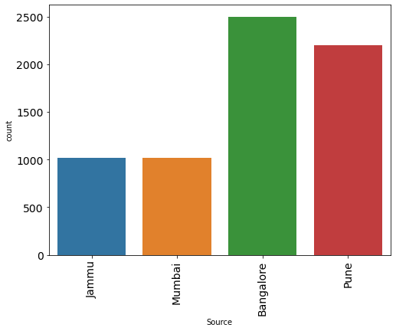
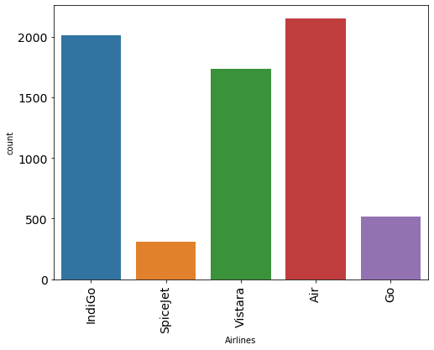
EDA
countplot(df['Airlines'])
Obseravtion
1-Mostly Source has bangalore as high count
2-after bangalore pune has 2nd high count
3-and at least jammu and mumbai equal count
Obseravtion
1-Mostly people use to travel with Air India
2-After air india people use to travel with IndiGo
3-ANd spicejet has the least count

Slide 8
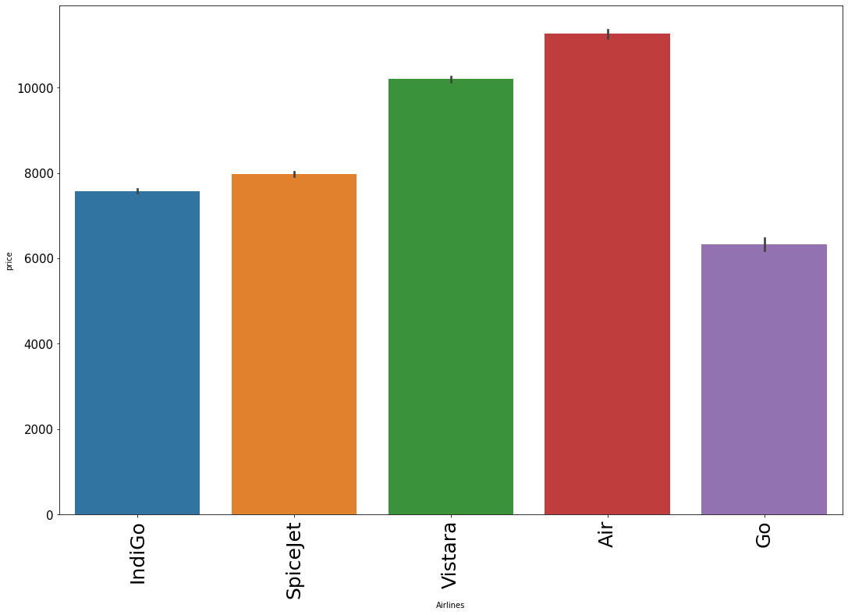
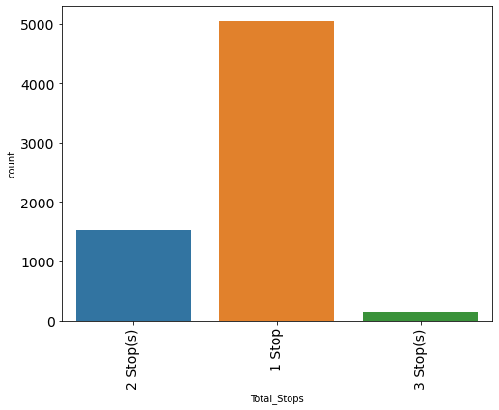
EDA
Obseravtion
1-Mostly people use to take a fligh who has only one stop
3-ANd only approx 1500 people use to take 2 stop flights
4-ANd there are very less people who used to take 3 stops or 4 stops flight

Slide 9
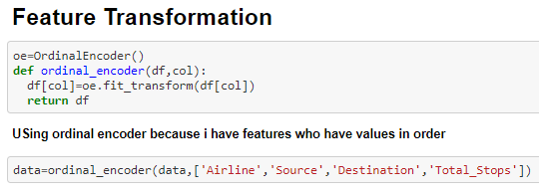
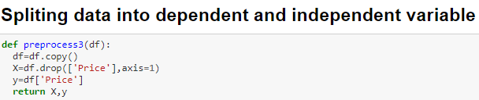
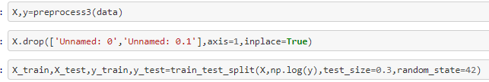
PREPARAING DATA FOR MACHINE LEARNING
OBSERAVTION-
Here I am using ordinal encoder because my features are in order
And I am splitting my data into x,y for train test split

Slide 10
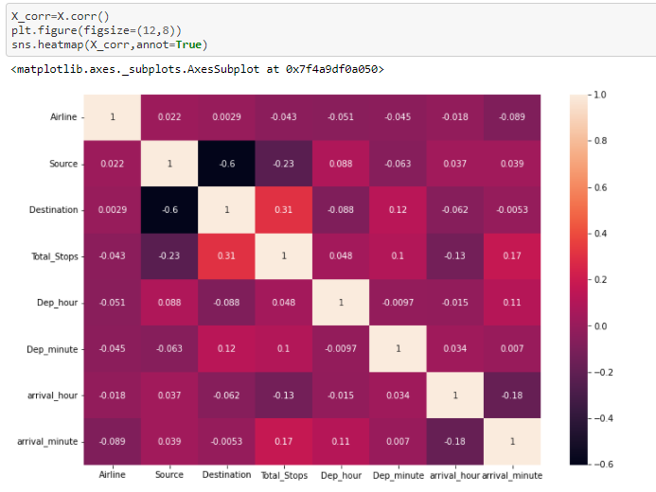
CHECKING CORRELATION BETWEEN FEATURES
OBSERVATION
from upper graph i can say most of the columns are having less correlation because most of every column is categorical and through this correlation we can only find correlation with numerical data

Slide 11
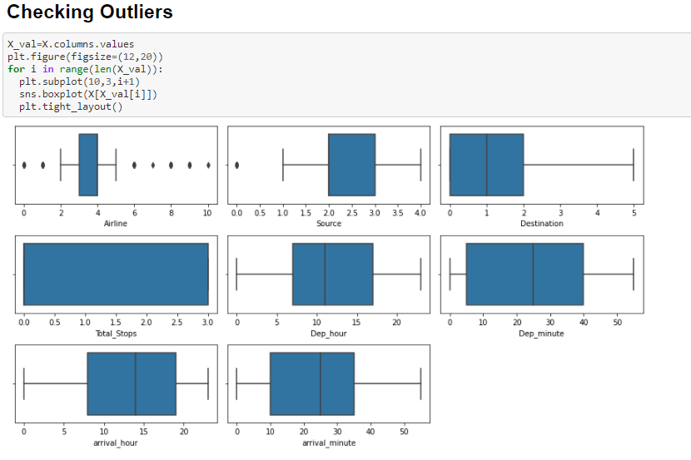
CHECKING OUTLIERS
OBSERVATION-
there is no outliers because every column is categorical we don't have any continuous column in X

Slide 12
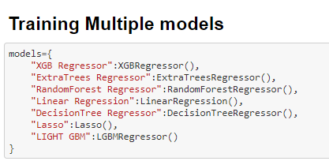
TRAINING MULTIPLE MODELS
NAME | Cross_Val_Score | R2_score | Mean_squared_error | Mean_Absolute_Error | RMSE
0 | XGB Regressor | 0.999999 | 0.999999 | 1.069399e-07 | 2.079237e-04 | 3.270167e-04
1 | ExtraTrees Regressor | 1.000000 | 1.000000 | 2.843791e-28 | 1.501941e-14 | 1.686354e-14
2 | RandomForest Regressor | 1.000000 | 1.000000 | 2.285704e-28 | 1.381318e-14 | 1.511854e-14
3 | Linear Regression | 0.311658 | 0.320709 | 5.683874e-02 | 1.819486e-01 | 2.384088e-01
4 | DecisionTree Regressor | 1.000000 | 1.000000 | 2.263136e-28 | 1.125642e-14 | 1.504372e-14
5 | Lasso | -0.000053 | -0.000011 | 8.367453e-02 | 2.198570e-01 | 2.892655e-01
6 | LIGHT GBM | 1.000000 | 0.999999 | 1.007051e-07 | 1.237600e-04 | 3.173406e-04
Here I have trained many model and I have used all the performance metrics as well to check my model performance and I have choose xgb regressor as my final model for hyperparameter tuning.

Slide 13
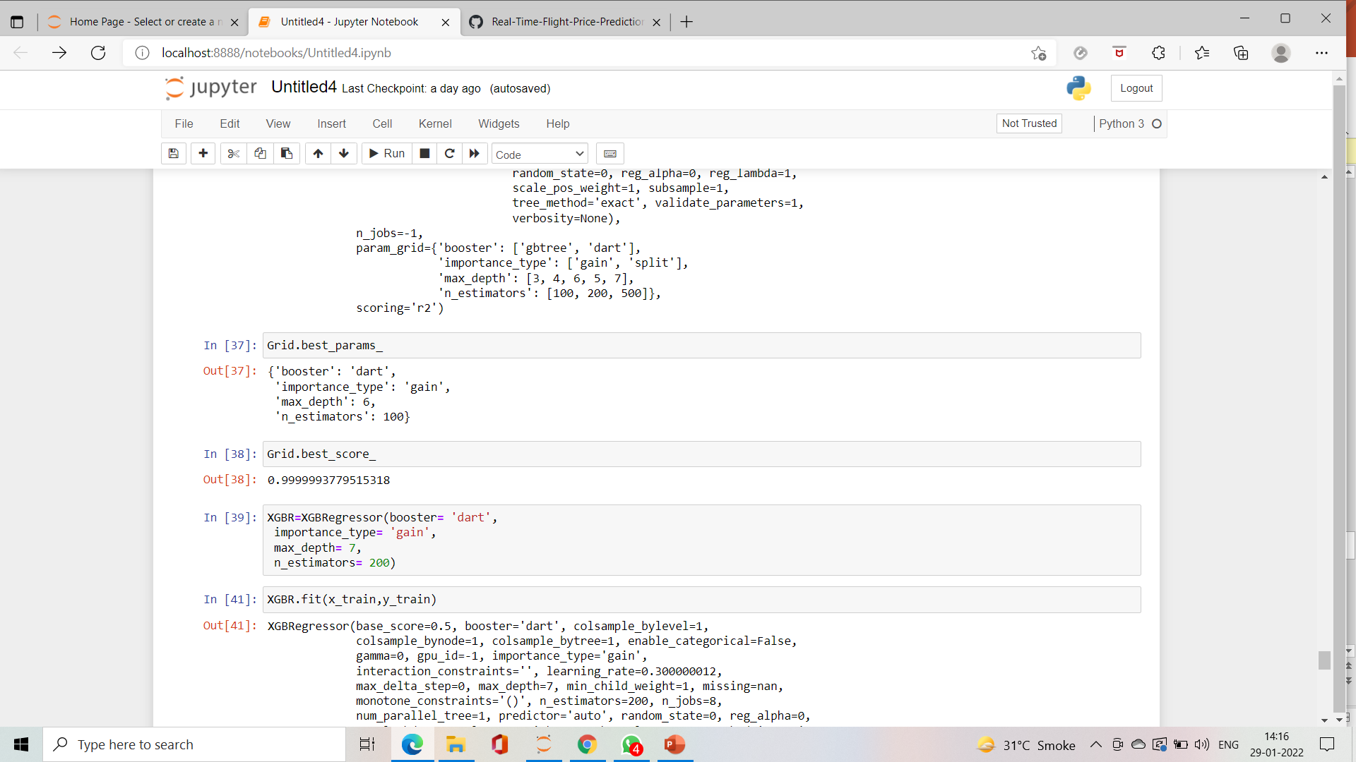
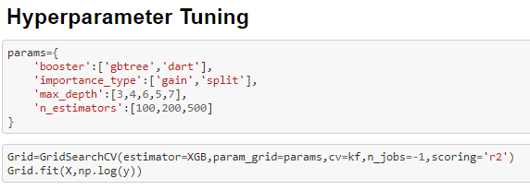
HYPERPARAMETER TUNING
Here I am doing hyperparameter tuning of my model so I can get better results
And after hyperparameter tuning we can see my best parameters of my models
So I can use this as my final model

Slide 14
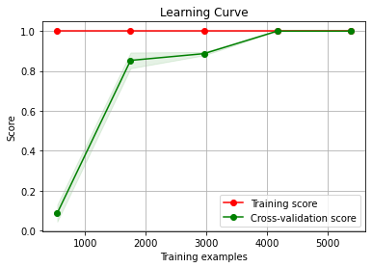
FINAL MODEL PERFORMANCE METRICS AND LEARNING CURVE
MSE 1.007616281689206e-07
MAE 0.00019756449622946223
RMSE 0.0003174297216218428
R2_Score 0.9999987957771047
Model_Score 0.9999987957771047
HERE WE CAN SEE THE FINAL MODEL LEARNING CURVE AS WELL AS THE PERFORMANCE METRICS OF MY FINAL MODEL

Slide 15
CONCLUSION
Learning Outcomes of the Study in respect of Data Science
The above research will help our client to study the latest flight price market and with the help of the model built he can easily predict the price ranges of the flight, and also will helps him to understand Based on what factors the fight price is decided.
Limitations of this work and Scope for Future Work
The limitation of the study is that in the volatile changing market we have taken the data, to be more precise we have taken the data at the time of pandemic and recent data, so when the pandemic ends the market correction might happen slowly. So based on that again the deciding factors of the might change and we have shortlisted and taken these data from the important cities across india, if the customer is from the different city our model might fail to predict the accuracy prize of that flight.

